Slide 1
Disposable ui
Tech con, 2017
Stan Anderson
Bin Li
Arun Venkatesh

Slide 2
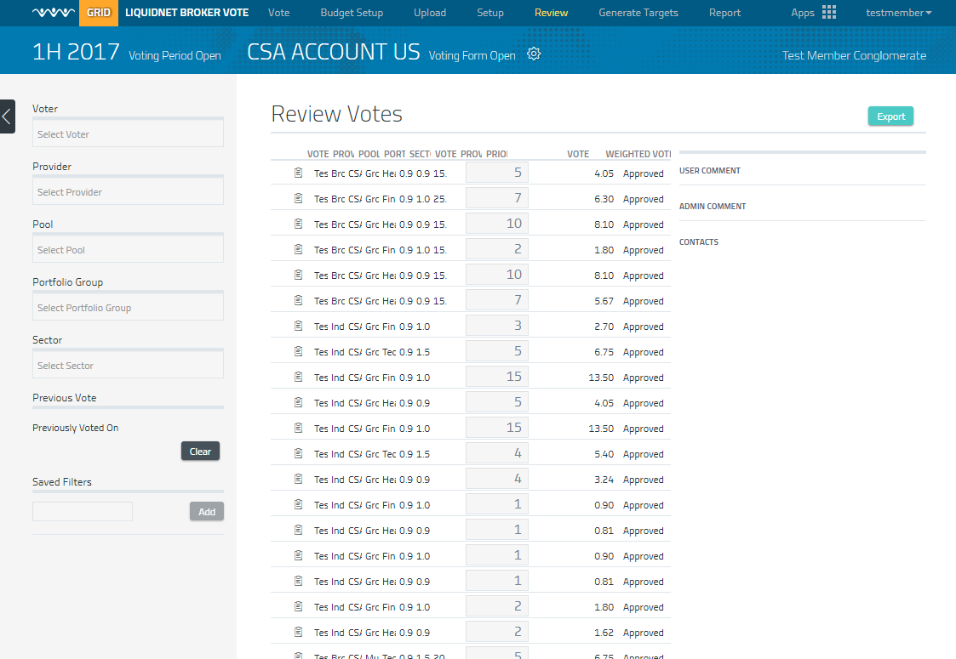
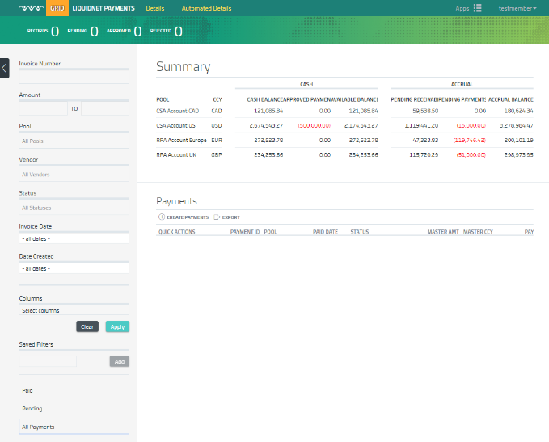
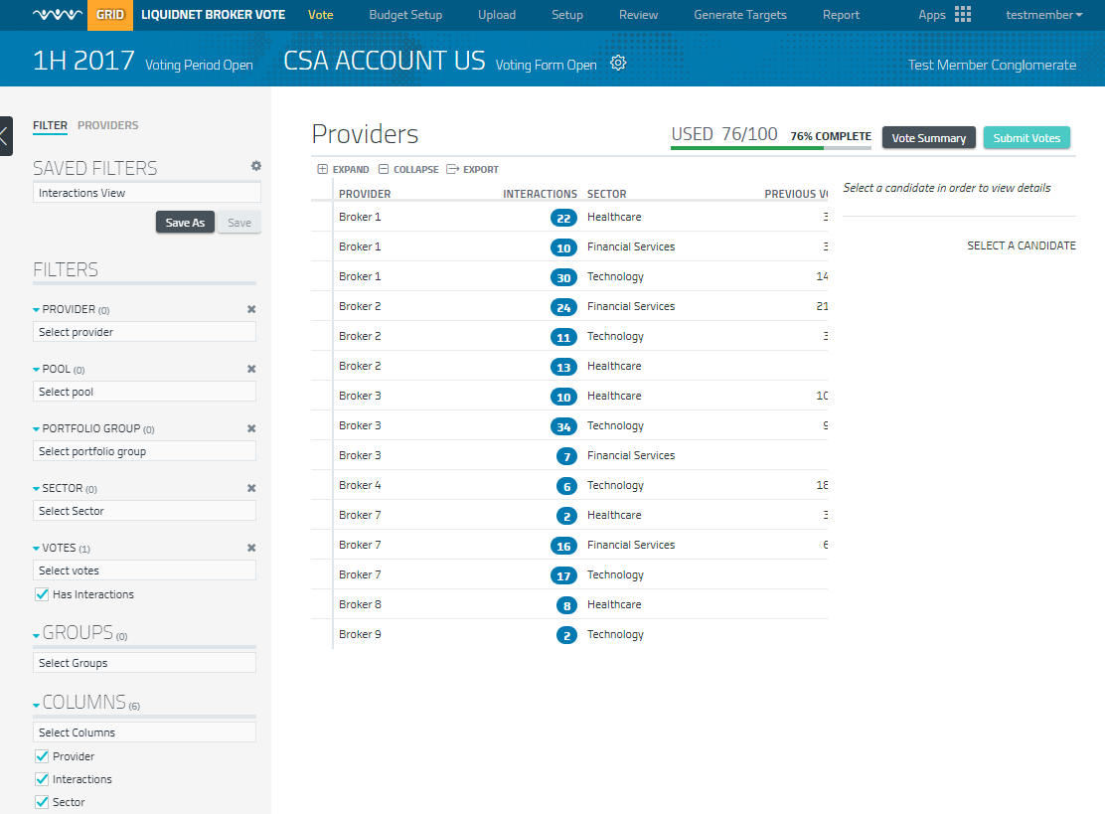
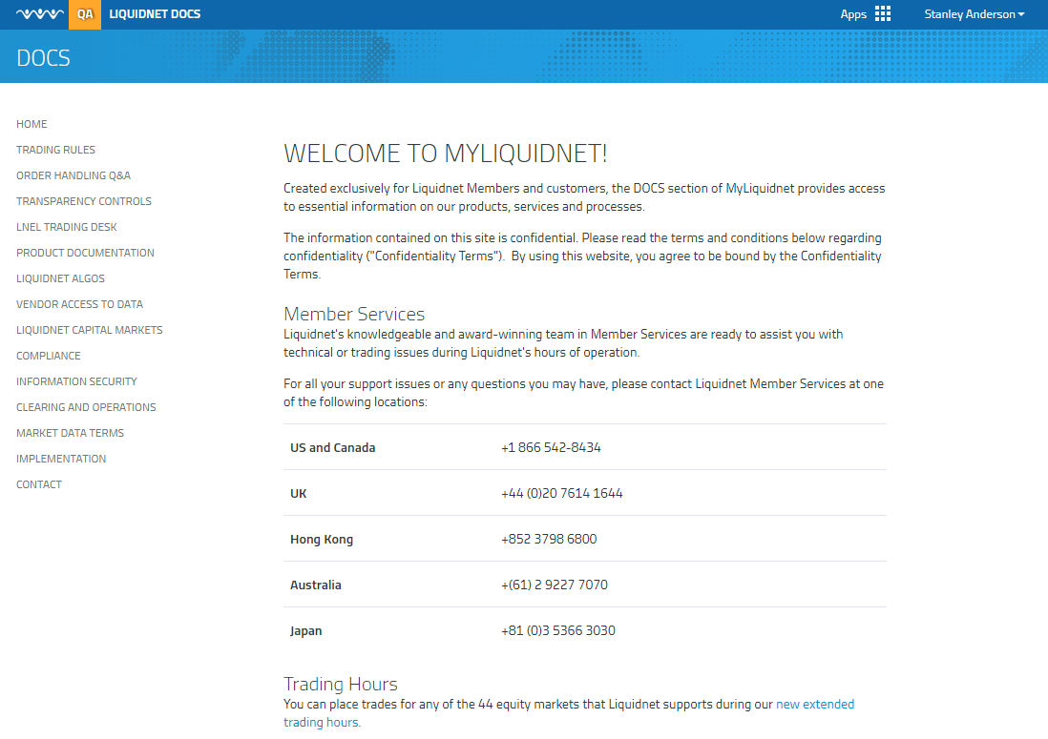

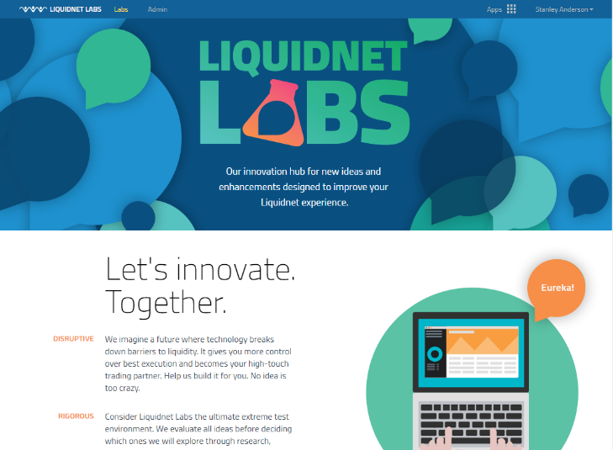
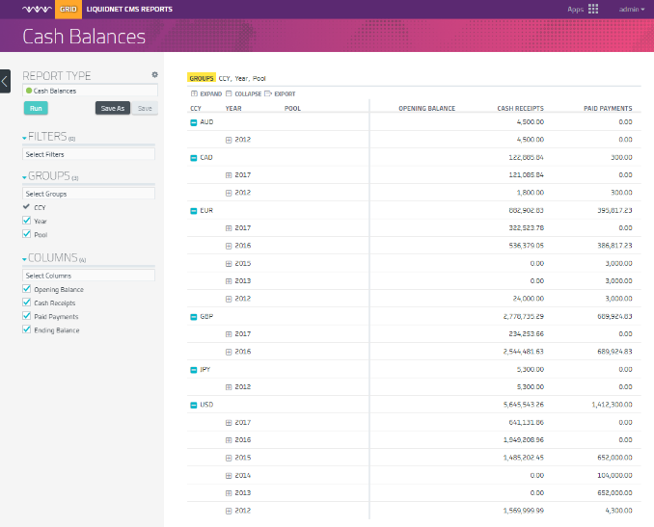
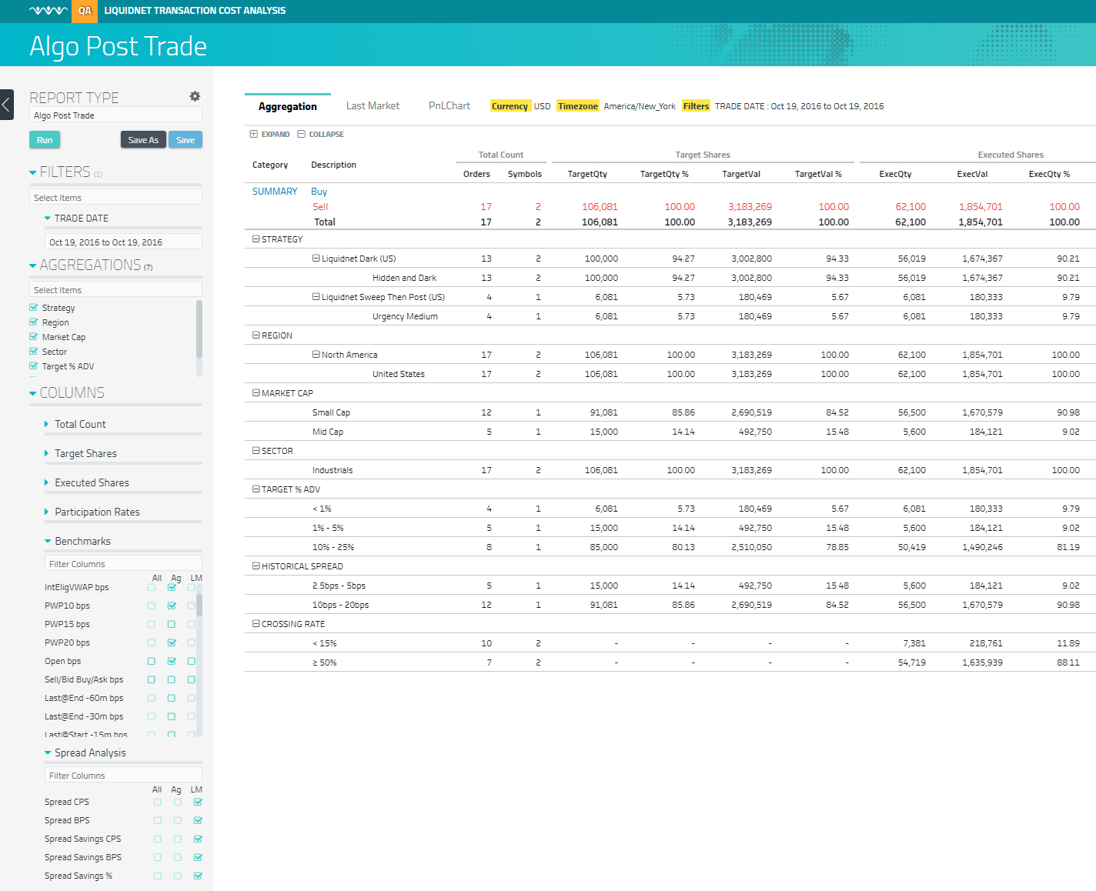
What is the Web Platform?
Single Sign On
LN5 Integration
Session Management
Content Management
Grid Data
Chart Data
Style Guide
Navigation
Filters/Selectors
Notes:
Web Platform addressed the need to bring our web applications onto a common platform
In doing this we found there was a need to share components which were common across apps

Slide 3
Why Not AngularJS?

Slide 4
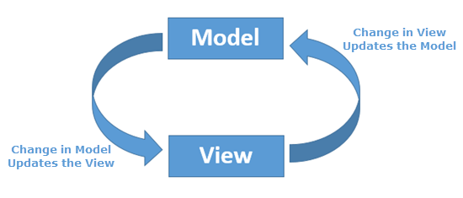
What Is AngularJS?
Java script framework for dynamic web app
MVC design pattern
Two way data binding
Multi Data store
Controller handles business logic within the component

Slide 5
Ideal scenario: independent components
Controller A
Model
View
Controller B
Model
View
Controller C
Model
View
Controller D
Model
View
Controller E
Model
View
Controller F
Model
View
Controller G
Model
View
Controller H
Model
View

Slide 6
A Little more complex…
LOT
Controller A (👁 x)
Model
View
Controller B (👁 x)
Model
View
Controller C (👁 x)
Model
View
Controller D
Model
View
Controller E
(emit event)
Controller F
Model
View
Model
View
Controller G
Model
View
Controller H
Model
View
Notes:
There will be hierarchy of controllers, which create a parent child relationship between component. The inheritance is done by javascript prototype. And some model will be fully or partially inherited by child controller. So when you are trying to watch a model or emit an event, you must be very clear about the hierarchy and inheritance information. In our past experience, the watch or emit callback function are not triggered because of this confusion. Even if you can design a very clear structure at the beginning, rapid business logic change, new developers work on unfamiliar area will make change to hierarchy structure and inheritance relationship. This will cause exiting watchers break and the system more fragile.
But this is not the worst, the business logic could change to reach out to outside scope, you change something in scope A, it needs to trigger a change to scope B and C, how does the component pass the message to your parent, child, siblings or even a stranger? Redesign the a new structure? Too expensive, pass everything to root scope, and watch everything in root scope? But this is not what angular is designed for.

Slide 7
Difficulties
Super clear about hierarchy and inheritance which is hard to maintain
Passing message across multi component
debugging
Performance of digest loop
B
A
C
Notes:
Let’s talk about debugging, think of an example, component A updated a model value, which triggered component B and C update their own model, which may trigger back component A to update again. This could happen in any framework, but in angular, everything is done by the framework dynamically, the sequence of the updated when and how, is transparent to developer. So when something is wrong, it’s very hard to trace at what point things start to go wrong.
There was one example when we worked on TCA web using angular, one user action invoked a function that update a bunch of model object, elsewhere in the application, there are a lot watchers watch these model object. So when this function is called, there are a lot of strange behavior happens, and the view is not updated as we expect, maybe there is a design flaw, but the problem is it’s hard to figure out the real reason. Angular digest loop and it’s own event scheduling hide all the intermediate change from developer. I can show you a code snippet in next slide, we end up using $timeout to make it work, but why it works we still have no clue, it’s more like a guess, it’s certainly not a good way to fix problem.

Slide 8
if(res.payload.updateGridOption){ $timeout(()=>{ console.log("update options on response "); $scope.reporting.detailGrid.updateOptions(res.gridOption, false); //not sure why this is needed, but the page breaks if this is omitted $scope.reporting.detailGrid.setGroupByColumns(mygroupBy); $scope.reporting.detailGrid.setFormatterPreferences(preferences); }, 0); } $timeout(()=>{ $scope.reporting.detailGridTotal = res.payload.total; $scope.reporting.detailGridData = res.payload.data; }, 0); // $scope.reporting.detailMetadata = res.payload.metadata; $scope.reporting.detailMetadata = metadataMergeTiming(res.payload.metadata); metadataFinalize(res.payload.metadata); // Equivalent of ready detection for reporting-view of main grid $timeout(()=>{ if( baseReport && baseReport.readyOnDetail ) baseReport.readyOnDetail(); },0);
Notes:
Let’s talk about debugging, think of an example, component A updated a model value, which triggered component B and C update their own model, which may trigger back component A to update again. This could happen in any framework, but in angular, everything is done by the framework dynamically, the sequence of the updated when and how, is transparent to developer. So when something is wrong, it’s very hard to trace at what point things start to go wrong.
There was one example when we worked on TCA web using angular, one user action invoked a function that update a bunch of model object, elsewhere in the application, there are a lot watchers watch these model object. So when this function is called, there are a lot of strange behavior happens, and the view is not updated as we expect, maybe there is a design flaw, but the problem is it’s hard to figure out the real reason. Angular digest loop and it’s own event scheduling hide all the intermediate change from developer. I can show you a code snippet in next slide, we end up using $timeout to make it work, but why it works we still have no clue, it’s more like a guess, it’s certainly not a good way to fix problem.

Slide 9

Choose a different path
Notes:
Let’s talk about debugging, think of an example, component A updated a model value, which triggered component B and C update their own model, which may trigger back component A to update again. This could happen in any framework, but in angular, everything is done by the framework dynamically, the sequence of the updated when and how, is transparent to developer. So when something is wrong, it’s very hard to trace at what point things start to go wrong.
There was one example when we worked on TCA web using angular, one user action invoked a function that update a bunch of model object, elsewhere in the application, there are a lot watchers watch these model object. So when this function is called, there are a lot of strange behavior happens, and the view is not updated as we expect, maybe there is a design flaw, but the problem is it’s hard to figure out the real reason. Angular digest loop and it’s own event scheduling hide all the intermediate change from developer. I can show you a code snippet in next slide, we end up using $timeout to make it work, but why it works we still have no clue, it’s more like a guess, it’s certainly not a good way to fix problem.

Slide 10
redux

Slide 11
What is Redux?
Predictable state container for JavaScript apps.
Consistent behavior
One-way (or unidirectional) data flow
Great developer experience

Slide 12
State
{
visibilityFilter: 'SHOW_ALL',
todos: [
{
text: 'Consider using Redux',
completed: true,
},
{
text: 'Keep all state in a single tree',
completed: false
}
]
}

Slide 13
Action
interface action {
type: string;
payload?: any;
}
store.dispatch({
type: 'COMPLETE_TODO',
index: 1
})
store.dispatch({
type: 'SET_VISIBILITY_FILTER',
filter: 'SHOW_COMPLETED'
})

Slide 14
Reducer (pure function)
interface reducer<t> {
(state: T, action: action): T;
}
function visibilityfilter
(state = 'SHOW_ALL', action) {
switch (action.Type) {
case 'SET_VISIBILITY_FILTER':
return action.Filter
default:
return state
}
}

Slide 15
demo

Slide 16
Three Principles
Single source of truth(store)
State is read-only(only way to change the state is to emit an action)
Changes are made with pure functions(reducers)

Slide 17
Combined Reducers
export default function todoApp(state = {}, action) {
return {
visibilityFilter: visibilityFilter(state.visibilityFilter, action),
todos: todos(state.todos, action)
}
}
const reducer = combineReducers({
a: doSomethingWithA,
b: processB,
c: c
})

Slide 18
Trade-off
Describe application state as plain objects and arrays.
Describe changes in the system as plain objects.
Describe the logic for handling changes as pure functions.
Verbose coding.

Slide 19
Libraries
React Redux
https://github.com/reactjs/react-redux
Angular-redux
https://github.com/angular-redux/store
Polymer-redux
https://github.com/tur-nr/polymer-redux
Vue-redux
https://github.com/revue/revue

Slide 20
Advantages
Simple unidirectional data flow
Persist / Pre-fill state
Easy debugging
Could maintain undo history
Easy refactoring
Supports TDD and fully tested business logics
UI updates only after all the state updates are complete
UI becomes disposable

Slide 21
Q & a

